Slide 1
FIRST AID-COMPANION
BY RAJEENA HANSDAK 4 April,2021

Slide 2
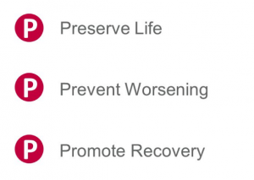
First aid –companion
Aim of emergency first aid
Preserve life
this includes your own life! You should never put yourself or others in danger.
Prevent deterioration
this aim includes preventing further injuries. You should attempt to make the area as safe as possible and removing any dangers
Promote recovery
Finally, you can promote recovery by arranging prompt emergency medical help

Slide 3
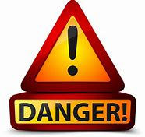
DANGER

Slide 4
rules
Rules of First Aid (Remember D.A.N.G.E.R.)
D Danger assess the situation and make sure you the victim and onlookers are safe
A (A.B.C.D of first is life sustaining, act quickly and confidently to check:-
A –airway
B –Breathing
C – Circulation, check pulse, control Haemorrhage
D – Degree of consciousness, note cause, give treatment

Slide 5
DRABC
First Aid Acronyms Explained – DRABC
D – Danger
R – Response
A – Airway
B – Breathing
C – Circulation

Slide 6
ROLE OF FIRST AIDER
The role of a first aider
First aid is the help given to someone who is injured or ill, to keep them safe until they can get more advanced medical treatment by seeing a doctor, health professional or go to hospital.
Assess the situation quickly and calmly:
Protect yourself and them from any danger:
Prevent infection between you and them:
Comfort and reassure:
Assess the casualty:
Give first aid treatment:
Arrange for the right kind of help:
• Call 999 for an ambulance if you think it’s serious
• Take or send them to hospital if it’s a serious condition but is unlikely to get worse
• For a less serious condition call 999 for medical advice (in England)
• Suggest they see their doctor if they’re concerned about a less serious condition
• Advise them to go home to rest, but to seek help if they feel worse
• Stay with them until you can leave them in the right care.

Slide 7
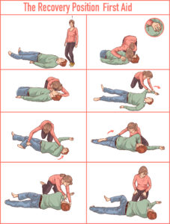

Slide 8
https://youtu.be/GmqXqwSV3bo

Slide 9
THE FIRST AIDER MUST BE ABLE TO ASSESS:-
1. Take a history (if possible)
The story behind the accident or illness
2. Signs Difference from normal that can be detected - pallor, pulse, etc.
3. Symptoms Sensations described by the patient - thirst, pain, nausea.
4. Diagnosis making a decision as cause of patient’s trauma.
5. Treatment Decide on priorities and act quickly

Slide 10
FIRST AIDER
N Never leave an unconscious person - place in the coma position and check pulse and breathing regularly.
G Get medical assistance when necessary.
E Examine the patient for further injuries and treat according to severity.
R Reassure the victim, handle him gently, and make arrangements to send patient to hospital, home,

Slide 11
Assessment
Danger:
Response:
Do they respond when you ask them: ‘Are you alright?’ or if you say: ‘Open your eyes!’
.
Airway:
Is their airway open and clear?
Breathing:
Are they breathing normally? You need to look, listen and feel to check they’re breathing.
Circulation:
Are there any signs of severe bleeding?

Slide 12
THE FIRST AIDER MUST KNOW HOW TO:-
Take the pulse in the radial and carotid arteries.

Slide 16
Measure the respiration rate – for 60secs

Slide 17
3. Take the TEMPERATURE
Take pulse, resp, temp
Adults 60-80/min 12-15/minute 98.6°F 36.9°C
Children 100/minute 15-20/minute 98.6°F 36.9°C
Infants 120/minute 20-25/minute 98.6°F 36.9°C

Slide 18
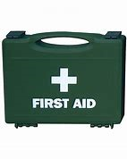
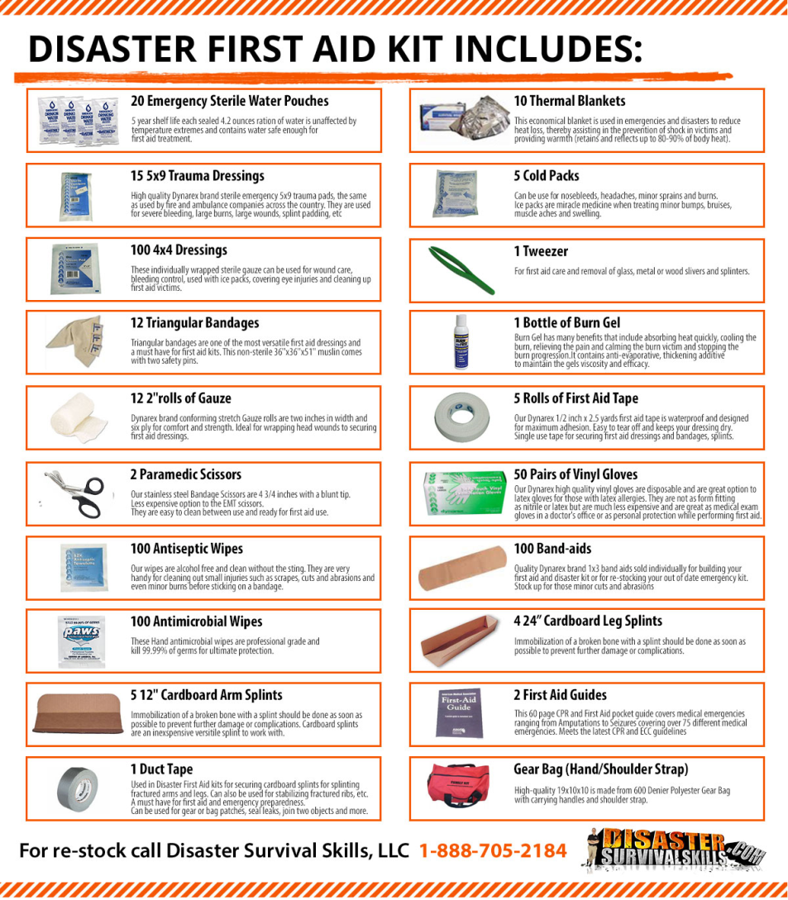
First aid kit

Slide 19
First Aid Kit Contents:-
• Wound dressings – eye pads, bandages
• Gauze,
• Tweezers
• Scissors
• Sterile water for eyes, tap water for other wounds
• Plasters- gel (splinter), blue (for catering, Clear
• Disposable gloves ( latex free)
• Vomit bags

Slide 20
BRAT diet for diarrhoea (banana, rice, apple, toast)
• Face shield ( for a love one)
• Tissues
• Wipes
• Adhesive tape
• Safety pins
• Aluminium blanket ?Why
• Eye wash
• Glucose (optional)

Slide 21
Skills of the first aider
Communication skills / interpersonal ability
Confidence
Ability to work under pressure
Attention to detail
Teamwork & Leadership

Slide 22
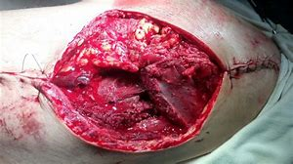
WOUND
An injury to living tissue caused by a cut, blow, or other impact, typically one in which the skin is cut or broken.

Slide 23
A wound is a break in the skin allowing entry of germs or damage to deeper tissues.
Cuts of any kind are best treated by:-
• Cleaning the surrounding area and the application of a mild antiseptic.
• Covering the wound with a suitable sterile dressing if available.

Slide 24
• If there are embedded objects, do not remove. Apply a ring pad or build up dressing to the area.
• Use gauze dressings direct on a wound, never cotton or wool
• If stitches (sutures) appear necessary, they should be done as soon as possible. Medical advice regarding tetanus injections should be sought.

Slide 25
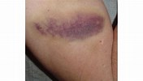
BRUISE
A bruise, also known as a contusion, is a type of hematoma of tissue in which capillaries are damaged by trauma, causing a localized internal bleeding that extravasate into the surrounding interstitial tissues.

Slide 26
The best treatment is elevation, application of an evaporating dressing and the application of a firm bandage. To reduce swelling, evaporating dressing should be applied for twenty minutes. Ice packs, gel packs, and water may also be used if correctly applied.

Slide 27
BLEEDING
Bleeding is the loss of blood from the circulatory system. Causes can range from small cuts and abrasions to deep cuts and amputations

Slide 28
https://youtu.be/N-JLGcktoZs

Slide 29
Act quickly as blood loss aggravates shock. Stop the bleeding using direct pressure on the wound where appropriate. Bandage using pad, ring pad, or build up dressing, and elevate the affected part.

Slide 30
TREATMENT FOR SHOCK (Circulatory Collapse)
This term refers to a condition met with in all medical emergencies. It is a state of collapse with a reduction of blood volume circulating to the brain and heart. Shock is caused by loss of body fluid from bleeding, burns, vomiting or diarrhoea, heart attack and poisoning, nervous reaction, and infection-Septic shock.

Slide 31
It is recognized by cold/clammy skin, rapid feeble pulse, rapid shallow breathing, and unconsciousness. The patient often feels faint or giddy, nauseated, and maybe thirsty. It is best handled by treating the cause as well with R. A. W.

Slide 32
R Rest Lie the patient down, legs elevated.
A Air Ensure adequate airway. Loosen clothing around the neck, chest and waist.
W Warmth Do not over-heat the body.

Slide 33
EXTERNAL BLEEDING
Severe external bleeding
Even a small injury can result in severe external bleeding, depending on where it is on the body. This can lead to shock. In medical terms, shock means the injured person no longer has enough blood circulating around their body. Shock is a life-threatening medical emergency.
First aid management for severe external bleeding includes: Check for danger before approaching the injured person. Put on a pair of gloves, nitrile ones, if available.
If possible, send someone else to call triple zero (000) for an ambulance.
Lie the person down. If a limb is injured, raise the injured area above the level of the person’s heart (if possible).
Get the person to apply direct pressure to the wound with their hand or hands to stem the blood flow. If the person can’t do it, apply direct pressure yourself.
You may need to pull the edges of the wound together before applying a dressing or pad. Secure it firmly with a bandage.
If an object is embedded in the wound, do not remove it. Apply pressure around the object.
Do not apply a tourniquet.
If blood saturates the initial dressing, do not remove it. Add fresh padding over the top and secure with a bandage.

Slide 34
INTERNAL BLEEDING
Internal bleeding – visible
The most common type of visible internal bleed is a bruise, when blood from damaged blood vessels leaks into the surrounding skin. Some types of internal injury can cause visible bleeding from an orifice (body opening). For example: bowel injury – bleeding from the anus
head injury – bleeding from the ears or nose
lung injury – coughing up frothy, bloodied sputum (spit)
urinary tract injury – blood in the urine.
Internal bleeding – not visible
It is important to remember that an injured person may be bleeding internally even if you can’t see any blood. An internal injury can sometimes cause bleeding that remains contained within the body; for example, within the skull or abdominal cavity.

Slide 35
NOSE BLEEDING
Most nose bleeds are minor and only last a few minutes, but they can be dangerous if someone loses a lot of blood.
If someone has had a blow to the head, the blood may appear thin and watery. This could mean that their skull is fractured and fluid is leaking from around the brain. If that happens, it is very serious and you should call 999 or 112 for emergency medical help. See advice for head injuries.
If someone is having a nose bleed, your priority is to control the bleeding and keep their airway open.
Get them to sit down (not lie down) as keeping the nose above the heart will reduce bleeding.
Get them to lean forward (not backwards), to make sure the blood drains out through their nose, rather than down their throat which could block their airway.
https://youtu.be/PmmhxW0vVXA

Slide 36
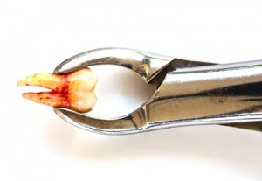
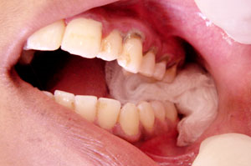
TOOTH SOCKET
A degree of blood oozing will occur from the extraction
site for the first 24 hours.
If fresh bleeding occurs, pressure should be applied to
the extraction site with a pack. This is achieved by
placing a rolled hankie, cotton wool or linen directly over
the site and biting hard. Pressure should be applied for >
20 minutes (some authorities suggest 45 - 60 minutes)
and this should stop the bleeding.

Slide 37
DRABC
First Aid Acronyms Explained – DRABC
D – Danger
R – Response
A – Airway
B – Breathing
C – Circulation

Slide 39


Slide 40
THANK YOU FOR YOUR
PARTICIPATION! BE ALERT!
AND
BE SAFE! GOD BLESS!!

