Slide 1
Adventurers DevelopmenT GrowtH
BST Train The Trainer
Course
January 31st, 2016
Presenter: Tyronne Waldron

Slide 2
I Like Cake
I mean, I really really like cake!

Slide 3
Prov. 22:6
Train up a child…and he will not depart.
Notes:
There is also:
matt 18:6: “Whoever causes one of these little ones who believe in Me to sin, it would be better for him if a millstone were hung around his neck, and he were drowned in the depth of the sea.

Slide 4
Objectives
To provide a very brief history of the Adventurer Club.
To develop an awareness of the Adventurer’s development.
To provide an awareness of the need for providing Discipline

Slide 5
tyronnewaldron@gmail.com
Answers will be given by 14th February!

Slide 6
History of Adventurers
Developed to assist parents.
1939 - GC endorsed classes.
1972 - Washington Conf. sponsored a club.
1975 - North Eastern Conf. had club concept.
1980 - Many Conf. sponsored clubs under various name.
1988 - 1990 - Club concept evaluated, and updated by NAD
2002 - SEC crossed 400 attendees at Camporee.
Notes:
from 1939 these classes were taught as part of the Adventist School system curricula, often as part of spiritual activities/worships.
1972 club was called Beavers; Clubs in Trinidad were called Blue Jays.

Slide 7
What’s Been Covered
Brief History of Adventurers

Slide 8
Exercise 1
Plan a lesson to teach the above.
Consider, Materials, Duration etc
Consider their Physical, Social, Emotional and Spiritual Stage

Slide 9
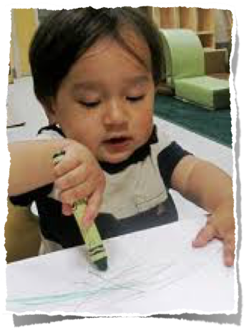
6-7 Year Old Characteristics
Small muscles are developing
Need Approval
Winning is paramount
Girls are ahead
Notes:
Physical: They can button their shirts, they can colour within the lines, they can write, they can work a scissors
Emotional: Experience new and intense feelings and needs assurance and approval; Sometimes can’t control behaviour.
Social: Wants to please his teacher. Winning is most important - sharing & taking turns, golden rule are difficult concepts

Slide 10
6-7 Year Old Characteristics
Eager to learn & thinks everyone shares their views
Need examples of Jesus showing love.
Need time to pray
Notes:
Intellectual: Likes to repeat stories/activities, can’t wait till tomorrow to do fun stuff, see parts - not parts make whole;
Spiritual: Omnipresence of God is accepted but only because parents and teachers communicate this through attitudes and actions. Understands the concept of talking to God - need time to pray

Slide 11
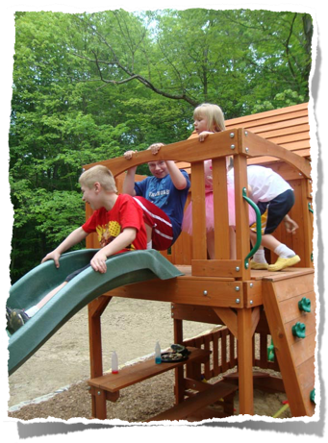
Teaching Tips 6-7 Year Olds
Cutting, Writing, Moving
Know Names & Love them
Encourage taking turns
Notes:
Physical - Use activities that involve cutting and writing skills; give children opportunities to move about; vary the activities. Children can sing rounds with some guidance.
Emotional - child in your class KNOWS and FEELS you love him. Show genuine interest in him and his activities and accomplishments. Learn children’s names and use them frequently
Social - encourage taking turns, Call attention to times when the group cooperated successfully.

Slide 13
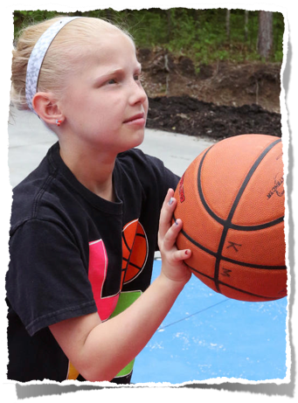
8-9 Year Old Characteristics
Good Muscle co-ordination
Can work longer periods
Developing identity & sense of right and wrong
Status and peer group
Notes:
Physical: Good small and large muscle coordination. Hand & Eye Coordination. Can work diligently when completing tasks but become impatient with delays or their own slowness. The girls are still ahead at this stage.
Emotional: The age of teasing, nicknames and criticisms. This is also the time the verbal skills develop and they are able to vent anger. At 8 your adventurer is developing a sense of fair play, right and wrong a value system. At 9 they begin a keen search for identity.
Social: The desire for status in the peer group becomes intense and there is less dependance on adults.

Slide 14
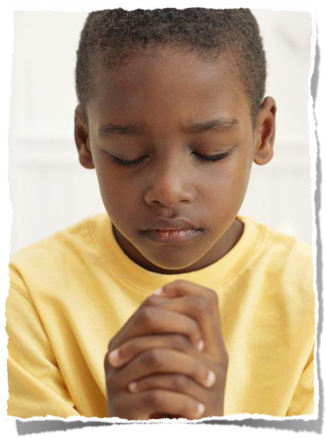
8-9 Year Old Characteristics
Varied opinions & Reasoning.
Creativity
Desire for a personal saviour
Keen sense for God’s guidance
Notes:
Intellectual: Your adventurer is beginning to understand that there are other valid opinions and is becoming a reasoning person and beginning to think in terms of the whole. Beginning to think conceptually and has a high level of creativity.
Spiritual: Beginning to sense the need for God’s continuos guidance and help. Your adventurer recognises the need for a personal saviour and has the desire to become a part of God’s family. Children who indicate an awareness of sin and are concerned about accepting Jesus as their saviour need thoughtful guidance without pressure.

Slide 15
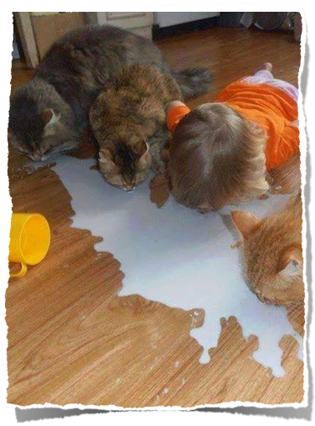
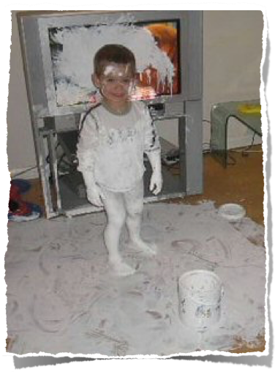
8-9 Year Old Characteristics
Clear instruction & allow independence.
Encourage creativity & self concept.
Promote research
Provide opportunities for worship.
Notes:
Physical - Clear and specific instructions. *Save on Computer*. Let Kids prepare own materials. Let them clean up.
Emotional - Great opportunity to present a christian model, at this stage children are eagerly searching for a model. Provide them with opportunities to channel their unique creativity and development of their self concept.
Social - This is a good stage to work in pairs or smaller units.
Intellectual - Encourage kids to look up information and discover the answers for themselves to problems. Use art , music, drama in order to appeal to a wide range of inclinations within your class. Bible research, reading games and memory work are good for this age group.
Spiritual - Involve kids in work and service projects. Provide opportunities for them to participate in prayer, bible study and worship.

Slide 16
What’s Been Covered
Brief History of Adventurers
Awareness of Adventurer Development

Slide 18
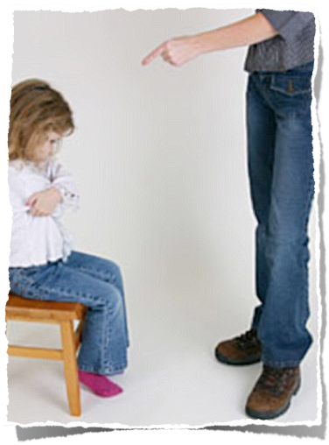
Discipline
Be an Example
Organized Room
Be Prepared
Set Specific Expectations
Redirect Misbehaviour
Notes:
Providing discipline for the Adventurer child is a positive contribution to his happiness and well-being. Discipline is not primarily punishment, but a way of helping the child to learn self-control and caring for others as a disciple of Jesus.
• Model the behavior you want
• Provide a peaceful, organized room • Be prepared
• Set specific expectations
• Consistently redirect misbehavior

Slide 19
What’s Been Covered
Brief History of Adventurers
Awareness of Adventurer Development
Awareness of the need for Discipline

Slide 21
tyronnewaldron@gmail.com
Answers will be given by 14th February!

Slide 22
Resources
http://www.adventurer-club.org/AdvancedLeadership/AgeLevelCharacteristics.pdf
The Adventurer Manual on your new memory stick :-)

